Slide 1
Creating Views and Index
Md. Ariful Islam Khandaker

Slide 2
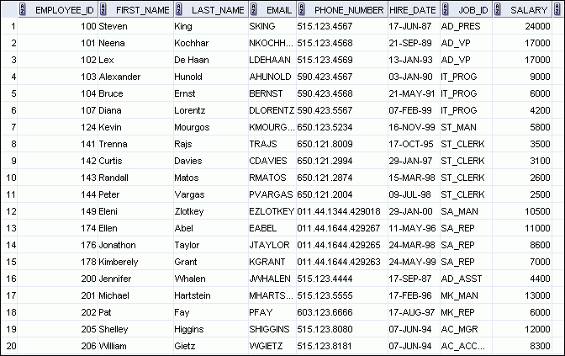
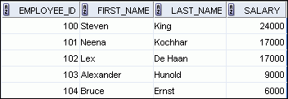
What Is a View?
EMPLOYEES table
Notes:
Oracle Database 11g: SQL Fundamentals I 11 - <number>
What Is a View?
You can present logical subsets or combinations of data by creating views of tables. A view is a logical table based on a table or another view. A view contains no data of its own, but is like a window through which data from tables can be viewed or changed. The tables on which a view is based are called base tables. The view is stored as a SELECT statement in the data dictionary.

Slide 3

Advantages of Views
To restrict
data access
To make complex queries easy
To provide data independence
To present different views of the same data
Notes:
Oracle Database 11g: SQL Fundamentals I 11 - <number>
Advantages of Views
Views restrict access to the data because it displays selected columns from the table.
Views can be used to make simple queries to retrieve the results of complicated queries. For example, views can be used to query information from multiple tables without the user knowing how to write a join statement.
Views provide data independence for ad hoc users and application programs. One view can be used to retrieve data from several tables.
Views provide groups of users access to data according to their particular criteria.
For more information, see the section on “CREATE VIEW” in the Oracle Database SQL Language Reference 11g, Release 1 (11.1).

Slide 4
Simple Views and Complex Views
Feature
Simple Views
Complex Views
Number of tables
One
One or more
Contain functions
No
Yes
Contain groups of data
No
Yes
DML operations through a view
Yes
Not always
Notes:
Oracle Database 11g: SQL Fundamentals I 11 - <number>
Simple Views and Complex Views
There are two classifications for views: simple and complex. The basic difference is related to the DML (INSERT, UPDATE, and DELETE) operations.
A simple view is one that:
Derives data from only one table
Contains no functions or groups of data
Can perform DML operations through the view
A complex view is one that:
Derives data from many tables
Contains functions or groups of data
Does not always allow DML operations through the view

Slide 5
Creating a View
  You embed a subquery in the CREATE VIEW statement:
CREATE [OR REPLACE] VIEW view
[(alias[, alias]...)]
AS subquery
[WITH READ ONLY [CONSTRAINT constraint]];
Notes:
Oracle Database 11g: SQL Fundamentals I 11 - <number>
Creating a View
You can create a view by embedding a subquery in the CREATE VIEW statement.
In the syntax:
OR REPLACE Re-creates the view if it already exists
FORCE Creates the view regardless of whether or not the base tables exist
NOFORCE Creates the view only if the base tables exist (This is the default.)
view Is the name of the view
alias Specifies names for the expressions selected by the view’s query (The number of aliases must match the number of expressions selected by the view.)
subquery Is a complete SELECT statement (You can use aliases for the columns in the SELECT list.)
WITH CHECK OPTION Specifies that only those rows that are accessible to the view can be inserted or updated
constraint Is the name assigned to the CHECK OPTION constraint
WITH READ ONLY ensures that no DML operations can be performed on this view
Note: In SQL Developer, click the Run Script icon or press [F5] to run the data definition language (DDL) statements. The feedback messages will be shown on the Script Output tabbed page.

Slide 6
Creating a View
  Create the EMPVU80 view, which contains details of the employees in department 80:
  Describe the structure of the view by using the iSQL*Plus DESCRIBE command:
CREATE VIEW empvu80
AS SELECT employee_id, last_name, salary
FROM employees
WHERE department_id = 80;
DESCRIBE empvu80
Notes:
Oracle Database 11g: SQL Fundamentals I 11 - <number>
Creating a View (continued)
The example in the slide creates a view that contains the employee number, last name, and salary for each employee in department 80.
You can display the structure of the view by using the DESCRIBE command.
Guidelines
The subquery that defines a view can contain complex SELECT syntax, including joins, groups, and subqueries.
If you do not specify a constraint name for the view created with the WITH CHECK OPTION, the system assigns a default name in the SYS_Cn format.
You can use the OR REPLACE option to change the definition of the view without dropping and re-creating it, or regranting the object privileges previously granted on it.

Slide 7
Creating a View
  Create a view by using column aliases in the subquery:
  Select the columns from this view by the given alias names.
CREATE VIEW salvu50
AS SELECT employee_id ID_NUMBER, last_name NAME,
salary*12 ANN_SALARY
FROM employees
WHERE department_id = 50;
Notes:
Oracle Database 11g: SQL Fundamentals I 11 - <number>
Creating a View (continued)
You can control the column names by including column aliases in the subquery.
The example in the slide creates a view containing the employee number (EMPLOYEE_ID) with the alias ID_NUMBER, name (LAST_NAME) with the alias NAME, and annual salary (SALARY) with the alias ANN_SALARY for every employee in department 50.
Alternatively, you can use an alias after the CREATE statement and before the SELECT subquery. The number of aliases listed must match the number of expressions selected in the subquery.
CREATE OR REPLACE VIEW salvu50 (ID_NUMBER, NAME, ANN_SALARY)
AS SELECT employee_id, last_name, salary*12
FROM employees
WHERE department_id = 50;

Slide 8
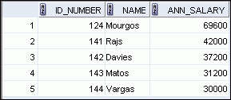
Retrieving Data from a View
SELECT *
FROM salvu50;
Notes:
Oracle Database 11g: SQL Fundamentals I 11 - <number>
Retrieving Data from a View
You can retrieve data from a view as you would from any table. You can display either the contents of the entire view or just specific rows and columns.

Slide 9
Modifying a View
  Modify the EMPVU80 view by using a CREATE OR REPLACE VIEW clause. Add an alias for each column name:
  Column aliases in the CREATE OR REPLACE VIEW clause are listed in the same order as the columns in the subquery.
CREATE OR REPLACE VIEW empvu80
(id_number, name, sal, department_id)
AS SELECT employee_id, first_name || ' '
|| last_name, salary, department_id
FROM employees
WHERE department_id = 80;
Notes:
Oracle Database 11g: SQL Fundamentals I 11 - <number>
Modifying a View
With the OR REPLACE option, a view can be created even if one exists with this name already, thus replacing the old version of the view for its owner. This means that the view can be altered without dropping, re-creating, and regranting object privileges.
Note: When assigning column aliases in the CREATE OR REPLACE VIEW clause, remember that the aliases are listed in the same order as the columns in the subquery.

Slide 10
Creating a Complex View
Create a complex view that contains group functions to display values from two tables:
CREATE OR REPLACE VIEW dept_sum_vu
(name, minsal, maxsal, avgsal)
AS SELECT d.department_name, MIN(e.salary),
MAX(e.salary),AVG(e.salary)
FROM employees e JOIN departments d
ON (e.department_id = d.department_id)
GROUP BY d.department_name;
Notes:
Oracle Database 11g: SQL Fundamentals I 11 - <number>
Creating a Complex View
The example in the slide creates a complex view of department names, minimum salaries, maximum salaries, and the average salaries by department. Note that alternative names have been specified for the view. This is a requirement if any column of the view is derived from a function or an expression.
You can view the structure of the view by using the DESCRIBE command. Display the contents of the view by issuing a SELECT statement.
SELECT *
FROM dept_sum_vu;

Slide 11


Rules for Performing
DML Operations on a View
  You can usually perform DML operations on
  simple views.
  You cannot remove a row if the view contains the following:
    Group functions
    A GROUP BY clause
    The DISTINCT keyword
Notes:
Oracle Database 11g: SQL Fundamentals I 11 - <number>
Rules for Performing DML Operations on a View
You can perform DML operations on data through a view if those operations follow certain rules.
You can remove a row from a view unless it contains any of the following:
Group functions
A GROUP BY clause
The DISTINCT keyword
The pseudocolumn ROWNUM keyword

Slide 12
Rules for Performing
DML Operations on a View
You cannot modify data in a view if it contains:
  Group functions
  A GROUP BY clause
  The DISTINCT keyword
  The pseudocolumn ROWNUM keyword
  Columns defined by expressions
Notes:
Oracle Database 11g: SQL Fundamentals I 11 - <number>
Rules for Performing DML Operations on a View (continued)
You can modify data through a view unless it contains any of the conditions mentioned in the previous slide or columns defined by expressions (for example, SALARY * 12).

Slide 13
Rules for Performing
DML Operations on a View
You cannot add data through a view if the view includes:
  Group functions
  A GROUP BY clause
  The DISTINCT keyword
  Columns defined by expressions
  NOT NULL columns in the base tables that are not selected by the view
Notes:
Oracle Database 11g: SQL Fundamentals I 11 - <number>
Rules for Performing DML Operations on a View (continued)
You can add data through a view unless it contains any of the items listed in the slide. You cannot add data to a view if the view contains NOT NULL columns without default values in the base table. All the required values must be present in the view. Remember that you are adding values directly to the underlying table through the view.
For more information, see the section on “CREATE VIEW” in Oracle Database SQL Language Reference 11g, Release 1 (11.1).

Slide 14
Denying DML Operations
CREATE OR REPLACE VIEW empvu10
(employee_number, employee_name, job_title)
AS SELECT employee_id, last_name, job_id
FROM employees
WHERE department_id = 10;
Notes:
Oracle Database 11g: SQL Fundamentals I 11 - <number>
Denying DML Operations (continued)
Any attempt to remove a row from a view with a read-only constraint results in an error:
DELETE FROM empvu10
WHERE employee_number = 200;
Similarly, any attempt to insert a row or modify a row using the view with a read-only constraint results in the same error.

Slide 15
Removing a View
You can remove a view without losing data because a view is based on underlying tables in the database.
DROP VIEW view;
DROP VIEW empvu80;
Notes:
Oracle Database 11g: SQL Fundamentals I 11 - <number>
Removing a View
You use the DROP VIEW statement to remove a view. The statement removes the view definition from the database. However, dropping views has no effect on the tables on which the view was based. On the other hand, views or other applications based on the deleted views become invalid. Only the creator or a user with the DROP ANY VIEW privilege can remove a view.
In the syntax:
view is the name of the view

Slide 16
Indexes
An index can be created in a table to find data more quickly and efficiently.
The users cannot see the indexes, they are just used to speed up searches/queries.
SQL CREATE INDEX Syntax
Creates an index on a table. Duplicate values are allowed:
CREATE INDEX index_name ON table_name (column_name)
SQL CREATE UNIQUE INDEX Syntax
Creates a unique index on a table. Duplicate values are not allowed:
CREATE UNIQUE INDEX index_name ON table_name (column_name)

Slide 17
CREATE INDEX Example
The SQL statement below creates an index named "PIndex" on the "LastName" column in the "Persons" table:
CREATE INDEX PIndex
ON Persons (LastName)
If you want to create an index on a combination of columns, you can list the column names within the parentheses, separated by commas:
CREATE INDEX PIndex
ON Persons (LastName, FirstName)

Slide 18
Thank to all

